Slide 1
TCP - Part II

Slide 2
What is Flow/Congestion/Error Control ?
Flow Control: Algorithms to prevent that the sender overruns the receiver with information
Error Control: Algorithms to recover or conceal the effects from packet losses
Congestion Control: Algorithms to prevent that the sender overloads the network
→ The goal of each of the control mechanisms are different.
→ In TCP, the implementation of these algorithms is combined

Slide 3

Acknowledgements in TCP
TCP receivers use acknowledgments (ACKs) to confirm the receipt of data to the sender
Acknowledgment can be added (“piggybacked”) to a data segment that carries data in the opposite direction
ACK information is included in the TCP header
Acknowledgements are used for flow control, error control, and congestion control
Data for B
A
Data for A
ACK
B
ACK

Slide 4
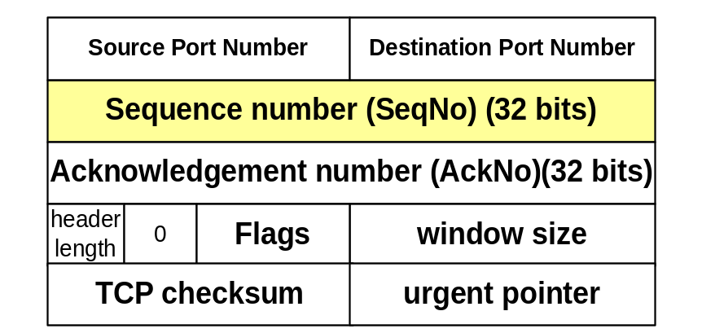
Sequence Numbers and Acknowledgments in TCP
TCP uses sequence numbers to keep track of transmitted and acknowledged data
Each transmitted byte of payload data is associated with a sequence number
Sequence numbers count bytes and not segments
Sequence number of first byte in payload is written in SeqNo field
Sequence numbers wrap when they reach 2³²-1
The sequence number of the first segment (Initial sequence number) is negotiated during connection setup

Slide 5
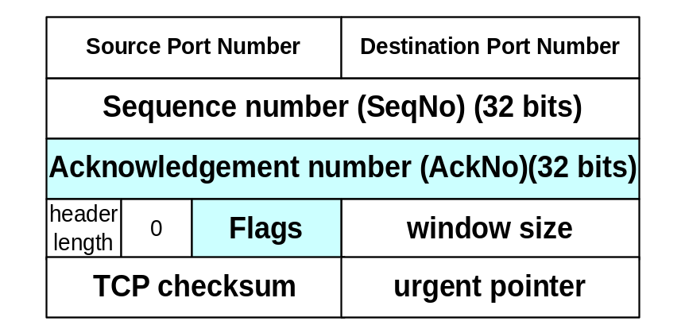
Sequence Numbers and Acknowledgments in TCP
An acknowledgment is a confirmation of delivery of data
When a TCP receiver wants to acknowledge data, it
  writes a sequence number in the AckNo field, and
  sets the ACK flag
IMPORTANT: An acknowledgment confirms receipt for all unacknowledged data that has a smaller sequence number than given in the AckNo field
Example: AckNo=5 confirms delivery for 1,2,3,4 (but not 5).

Slide 6
Cumulative Acknowledgements
TCP has cumulative acknowledgements:
An acknowledgment confirms the receipt of all unacknowledged data with a smaller sequence number
SeqNo=20
10 bytes
SeqNo=10
10 bytes
SeqNo=0
10 bytes
SeqNo=40
10 bytes
SeqNo=50
10 bytes
SeqNo=60
10 bytes
SeqNo=70
10 bytes
SeqNo=90
10 bytes
SeqNo=30
10 bytes
SeqNo=80
10 bytes
A
B
ACK 10
ACK 20
ACK 40
ACK 70
ACK 100

Slide 7
Cumulative Acknowledgements
With cumulative ACKs, the receiver can only acknowledge a segment if all previous segments have been received
With cumulative ACKs, receiver cannot selectively acknowledge blocks of segments:
e.g., ACK for S₀-S₃ and S₅-S₇ (but not for S₄)
Note: The use of cumulative ACKs imposes constraints on the retransmission schemes:
  In case of an error, the sender may need to retransmit all data that has not been acknowledged

Slide 8
Rules for sending Acknowledgments
TCP has rules that influence the transmission of acknowledgments
Rule 1: Delayed Acknowledgments
  Goal: Avoid sending ACK segments that do not carry data
  Implementation: Delay the transmission of (some) ACKs
Rule 2: Nagle’s rule
  Goal: Reduce transmission of small segments Implementation: A sender cannot send multiple segments with a 1-byte payload (i.e., it must wait for an ACK)

Slide 9
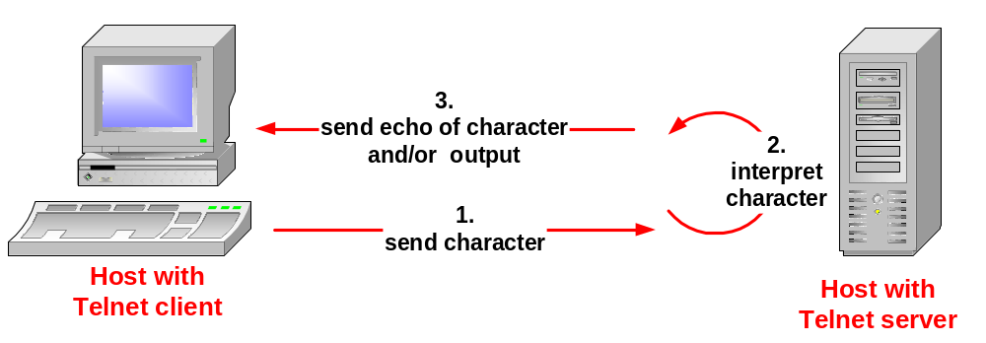
An Example – Telnet Application
Remote terminal applications (e.g., Telnet) send characters to a server. The server interprets the character and sends the output at the server to the client.
For each character typed, you see three packets:
  Client → Server: Send typed character
  Server → Client: Echo of character (or user output) and acknowledgement for first packet
  Client → Server: Acknowledgement for second packet

Slide 10
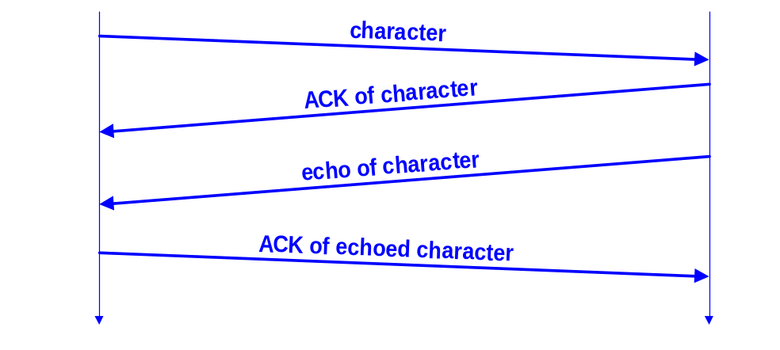
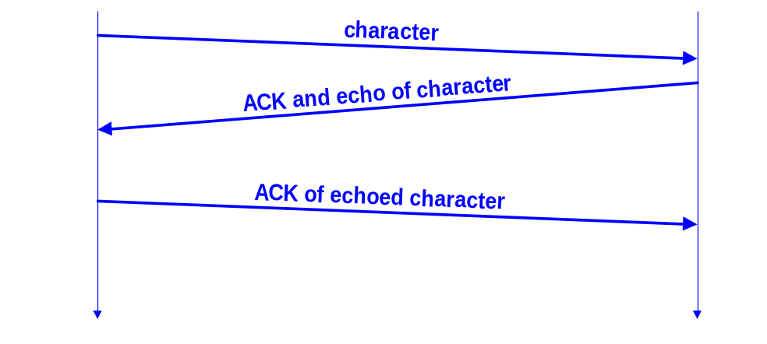
Why 3 segments per character?
We would expect four segments per character:
But we only see three segments per character:
This is due to delayed acknowledgements

Slide 11
Delayed Acknowledgement
TCP delays transmission of ACKs for up to 200ms
Goal: Avoid sending ACK packets that do not carry data.
  The hope is that, within the delay, the second host will have data ready to be sent to the first host. Then, the ACK can be piggybacked with a data segment
  In Example:
  Delayed ACK explains why the “ACK of character” and the “echo of character” are sent in the same segment
  The duration of delayed ACKs can be observed in the example when client sends ACKs
Exceptions:
ACK should be sent for every second full sized segment
Delayed ACK is not used when packets arrive out of order

Slide 12
Delayed Acknowledgement
Because of delayed ACKs, an ACK is often observed for every other segment
SeqNo=20
10 bytes
SeqNo=10
10 bytes
SeqNo=0
10 bytes
SeqNo=40
10 bytes
SeqNo=50
10 bytes
SeqNo=60
10 bytes
SeqNo=80
10 bytes
SeqNo=30
10 bytes
SeqNo=70
10 bytes
A
B
ACK 20
ACK 40
ACK 70
ACK 50
ACK 90
Max. Delay
for an ACK

Slide 13
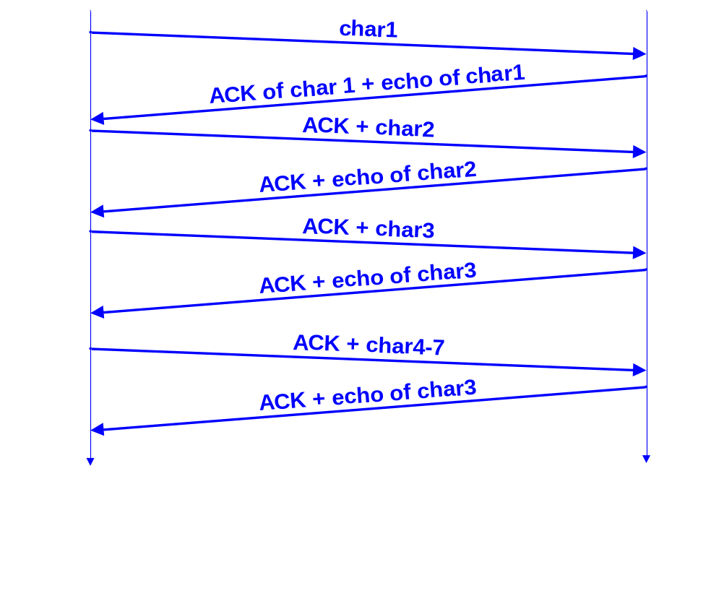
An Example – Telnet Application
Observation: Transmission of segments follows a different pattern, i.e., there are still two full segments per character typed
Delayed acknowledgment does not kick in at the client
The reason is that there is always data at client ready to send when the ACK arrives
To avoid this the client does not send the data (typed character) as soon as it is available?

Slide 14
Observing Nagle’s Rule
Observations:
  Client never has multiple unacknowledged segments outstanding
  There are fewer transmissions than there are characters.
This is due to Nagle’s Rule:
  Each TCP connection can have only one small (1-byte) segment outstanding that has not been acknowledged
Implementation: Send one byte and buffer all subsequent bytes until acknowledgement is received. Then send all buffered bytes in a single segment. (Only enforced if byte is arriving from application one byte at a time)
Goal of Nagle’s Rule: Reduce the amount of small segments.
  There is an option for disabling Nagle's algorithm

Slide 15
Nagle’s Rule
Only one 1-byte segment can be in transmission (Here: Since no data is sent from B to A, we also see delayed ACKs)
Typed
characters
A
SeqNo=1, 4 byte
SeqNo=0, 1 byte
SeqNo=5, 5 byte
B
ACK 1
ACK 5
ACK 10
Delayed ACK
Delayed ACK
Delayed ACK

Slide 16
Nagle's Algorithm
if there is new data to send
if the window size >= MSS and available data is >= MSS
send complete MSS segment now
else
if there is unconfirmed data still in the pipe
enqueue data in the buffer until an acknowledge is received
else
send data immediately
end if
end if
end if

Slide 17
Interaction between Nagle's Algorithm and Delayed ACK
  Receiver waits for data and sender waits for acknowledgement – results in starvation
An example –
Consider a request or reply flow -
  the size of the payload in the flow may not be an exact multiple of the MSS (the last packet of the flow will be smaller)
this last packet will not be transmitted until the previous packet is acknowledged.

Slide 18
Interaction between Nagle's Algorithm and Delayed ACK
In the best case, the penultimate packet represents an even-numbered packet, triggering an immediate acknowledgement from the receiver which in turn “releases” the final small packet.
  In this case, the Nagle penalty is equal to one network round-trip for the entire flow.
If the penultimate packet be an odd-numbered packet, it will not be acknowledged by the receiver until the Delayed ACK timer expires
  the penalty becomes one network round-trip plus approximately 200 milliseconds.

Slide 19
TCP Flow Control

Slide 20
TCP Flow Control
TCP uses a version of the sliding window flow control, where
    Sending acknowledgements is separated from setting the window size at sender
    Acknowledgements do not automatically increase the window size at sender side
During connection establishment, both ends of a TCP connection set the initial size of the sliding window

Slide 21
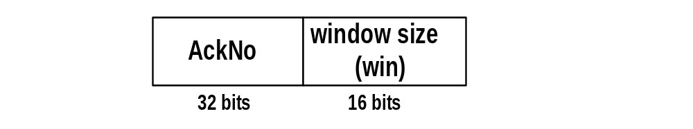
Window Management in TCP
The receiver is returning two parameters to the sender
The interpretation is:
    I am ready to receive new data with
    SeqNo= AckNo, AckNo+1, …., AckNo+Win-1
Receiver can acknowledge data without opening the window
        Without changing its size
Receiver can change the window size without acknowledging data

Slide 22
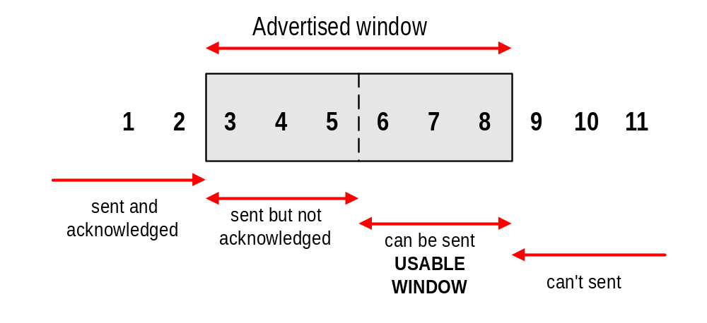
Sliding Window Flow Control
Sliding Window Protocol is performed at the byte level:
Here: Sender can transmit sequence numbers 6,7,8.

Slide 23
Example - 1
What is the value of the receiver window (rwnd) for host A if the receiver, host B, has a buffer size of 5,000 bytes and 1,000 bytes of received and unprocessed data?
The value of rwnd = 5,000 − 1,000 = 4,000. Host B can receive only 4,000 bytes of data before overflowing its buffer. Host B advertises this value in its next segment to A.

Slide 24
Example - 2
What is the size of the window for host A if the value of rwnd is 3,000 bytes and the value of cwnd is 3,500 bytes?
The size of the window is the smaller of rwnd and cwnd, which is 3,000 bytes.

Slide 25
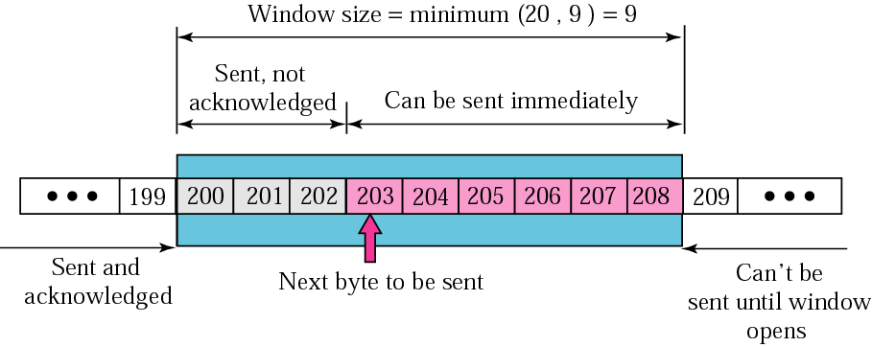
Example - 3
Assume that the sender has sent bytes up to 202 and cwnd is 20. The receiver has sent an acknowledgment number of 200 with an rwnd of 9 bytes.

Slide 26
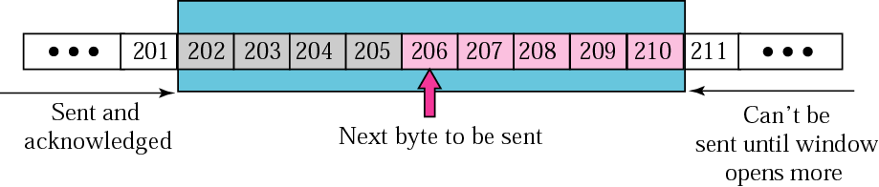
Example – 3 contd.
Next, the server receives a packet with an acknowledgment value of 202 and an rwnd of 9. The host has already sent bytes 203, 204, and 205. The value of cwnd is still 20.

Slide 27
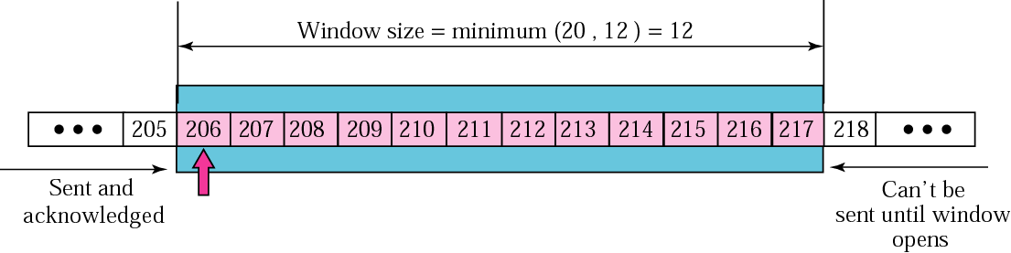
Example – 3 contd.
Next, the sender receives a packet with an acknowledgment value of 206 and an rwnd of 12. The host has not sent any new bytes. The value of cwnd is still 20.

Slide 28
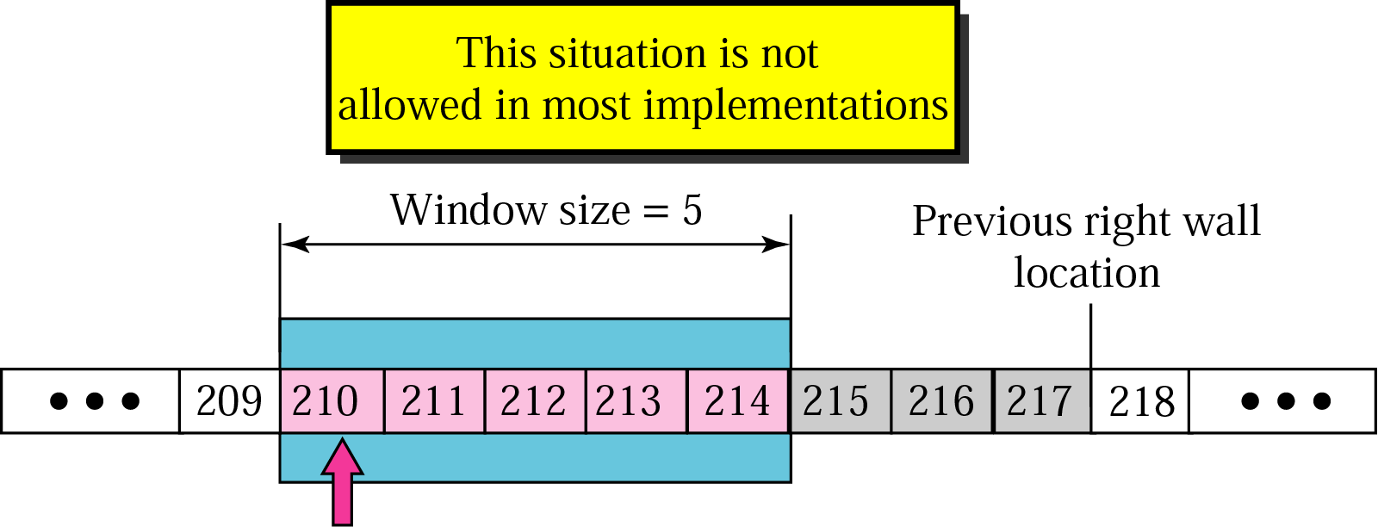
Example – 3 contd.
Assume the sender has sent bytes 206 to 209. The sender’s window shrinks accordingly.
Now the sender receives a packet with an acknowledgment value of 210 and an rwnd of 5. The value of cwnd is still 20.

Slide 29
Example – 3 contd.
Window Shutdown - While one shouldn’t shrink the window, one can send rwnd = 0 to close the window. Sender can still send a “probe” packet.

Slide 30
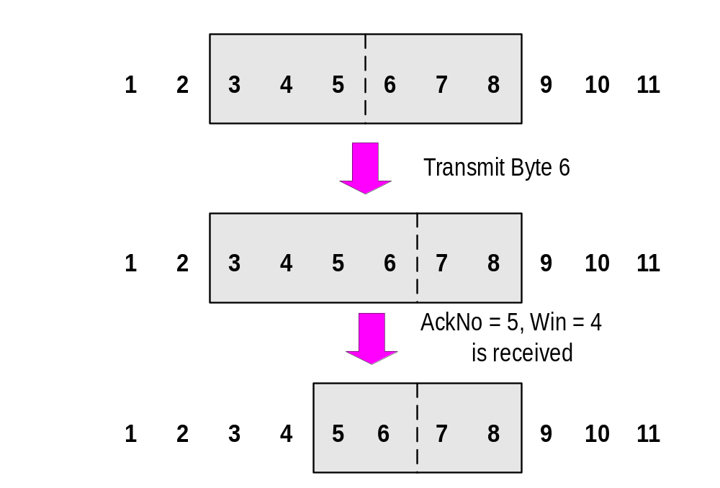
Sliding Window: “Window Closes”
Transmission of a single byte (with SeqNo = 6) and acknowledgement is received (AckNo = 5, Win=4):

Slide 31
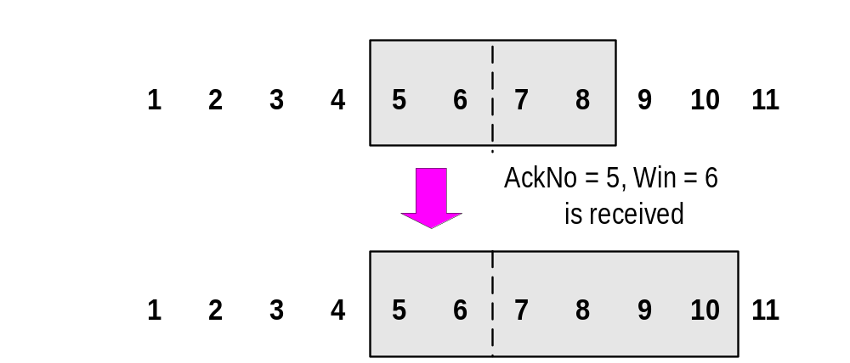
Sliding Window: “Window Opens”
Acknowledgement is received that enlarges the window to the right (AckNo = 5, Win=6):
A receiver opens a window when TCP buffer empties (meaning that data is delivered to the application).

Slide 32
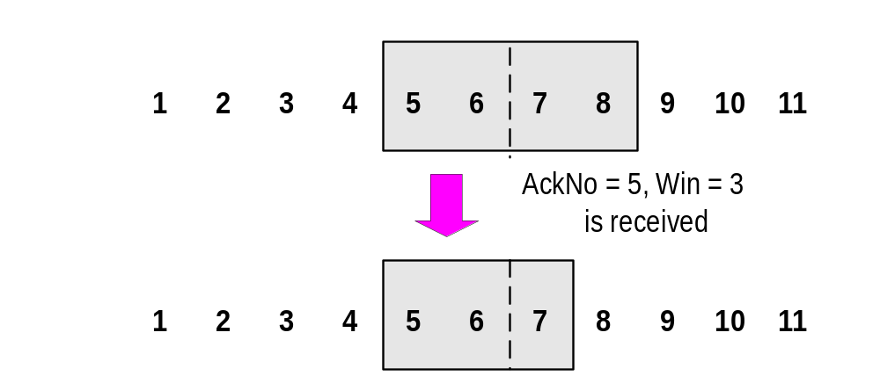
Sliding Window: “Window Shrinks”
Acknowledgement is received that reduces the window from the right (AckNo = 5, Win=3):
Shrinking a window should not be used

Slide 33
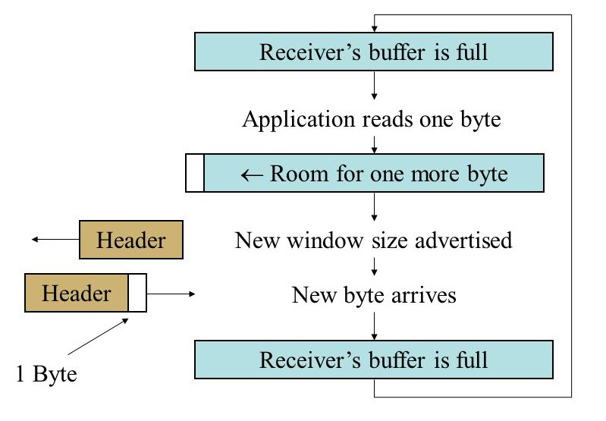
Silly Window Syndrome
What happens if the receiving TCP has a buffer size of 1000 bytes and the sending TCP has just sent 1000 bytes. The receiving buffer is now full so the receiver tells the sender to stop (window size = 0).

Slide 34
Silly Window Syndrome
Clark’s Solution - Acknowledge receipt right away, but don’t change the window size until you have at least half the buffer space available. Or, delay the ack until there is a decent amount of buffer space available.

Slide 35
TCP Error Control

Slide 36
Error Control in TCP
TCP Error Control –
  End-to-end reliability
    no corrupted segments
    no lost segments
    all segments in order

Slide 37
Error Control in TCP
TCP Error Control –
Tools for TCP Error Control
  Receiver side
    checksum – enables detection of corrupted segments on receiver’s side
    sequence numbers – enable detection of lost, out-of -order or duplicate segments on receiver side
  Sender side
    acknowledgments
    Retransmission timers

Slide 38
Error Control in TCP
TCP maintains a Retransmission Timer for each connection:
  The timer is started during a transmission. A timeout causes a retransmission
TCP couples error control and congestion control (i.e., it assumes that errors are caused by congestion)
  Retransmission mechanism is part of congestion control algorithm
Here: How to set the timeout value of the retransmission timer?

Slide 39
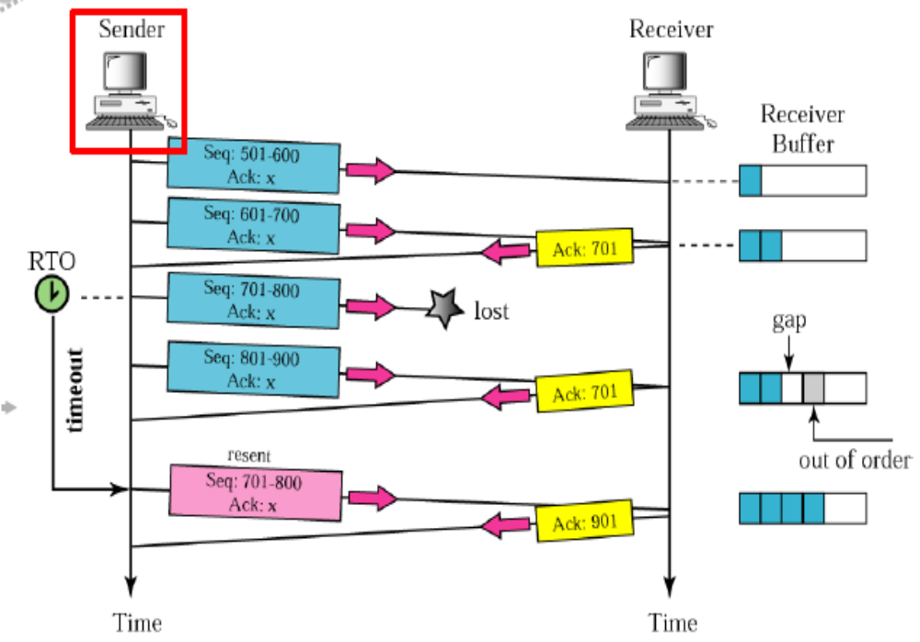

Slide 40
TCP Retransmission Timer
Retransmission Timer:
  The setting of the retransmission timer is crucial for efficiency
  A Timeout value is required
  Timeout value too small → results in unnecessary retransmissions
  Timeout value too large → long waiting time before a retransmission can be issued
  Delays in the network are not fixed
  Therefore, the retransmission timers must be adaptive

Slide 41
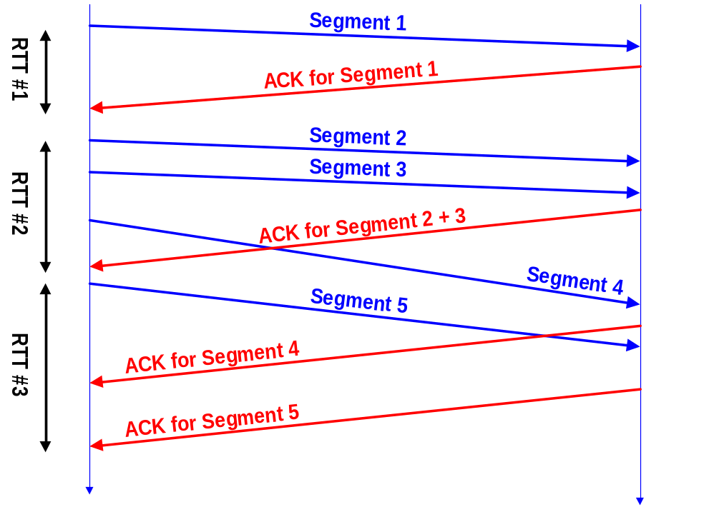
Round-Trip Time Measurements
The retransmission mechanism of TCP is adaptive
    Retransmission timer is set to a Retransmission Timeout (RTO) value.
    RTO is calculated based on the RTT measurements.
The RTT is based on time difference between segment transmission and ACK
But:
  TCP does not ACK each segment
  Each connection has only one timer

Slide 42
Round-Trip Time Measurements
Retransmission timer is set to a Retransmission Timeout (RTO) value.
RTO is calculated based on the RTT measurements.
a TCP sender maintains two state variables:
  SRTT (smoothed round-trip time) and
  RTTVAR (round-trip time variation)
Until a round-trip time (RTT) measurement is made for a segment sent between the sender and receiver, the sender SHOULD set RTO = 1 second
(RFC 6298)

Slide 43
Round-Trip Time Measurements
When the first RTT measurement R is made, the host MUST set
  SRTT = R, RTTVAR = R/2,
  RTO = SRTT + max (G, K*RTTVAR)
  where K = 4, clock granularity is G seconds
Every time when a new RTT measurement R’ is made, the following estimators srtt and rttvar are recalculated
rttvar = β ( | srtt – R’ | ) + (1- β ) rttvar
srtt = α R’ + (1- α ) srtt
The gains are set to α =1/8 and β =1/4
rttvar and srtt must be computed in the above order

Slide 44
Round-Trip Time Measurements
After setting the two values, RTO is updated as follows:
RTO = srtt + max (G, K*rttvar)
G is needed when K*rttvar equals to zero
It is observed that finer clock granularities (<= 100 msec) perform somewhat better than coarser granularities.

Slide 45
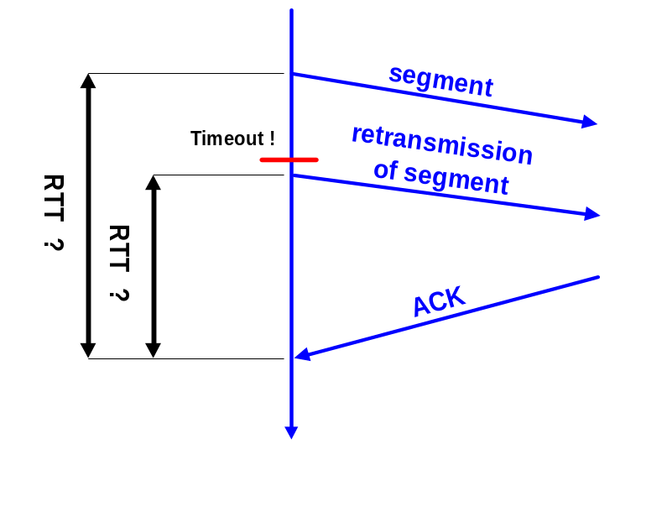
Karn’s Algorithm
If an ACK for a retransmitted segment is received, the sender cannot tell if the ACK belongs to the original or the retransmission.
Karn’s Algorithm:
  Don’t update srtt on any segments that have been retransmitted.
  Each time when TCP retransmits, it sets:
  RTO_{n+1} = max ( 2 RTO_{n} , 64) (exponential backoff)

Slide 46
Managing the RTO Timer
Placement On Retransmission Queue, Timer Start: As soon as a segment containing data is transmitted, a copy of the segment is placed in a data structure called the retransmission queue.
The queue is kept sorted by the time remaining in the retransmission timer, so the TCP software can keep track of which timers have the least time remaining before they expire.
Acknowledgment Processing: If an acknowledgment is received for a segment before its timer expires, the segment is removed from the retransmission queue.
Retransmission Timeout: If an acknowledgment is not received before the timer for a segment expires, a retransmission timeout occurs, and the segment is automatically retransmitted.

Slide 47
Managing the RTO Timer
1. Every time a packet containing data is sent (including a retransmission), if the timer is not running, start it running so that it will expire after RTO seconds (for the current value of RTO).
2. When all outstanding data has been acknowledged, turn off the retransmission timer.
3. When an ACK is received that acknowledges new data, restart the retransmission timer so that it will expire after RTO seconds (for the current value of RTO).

Slide 48
Managing the RTO Timer
Retransmit the earliest segment that has not been acknowledged by the TCP receiver.
5. The host MUST set RTO = RTO * 2 ("back off the timer"). A maximum value is set to provide an upper bound to this doubling operation.
6. Start the retransmission timer, such that it expires after RTO seconds.
7. If the timer expires awaiting the ACK of a SYN segment and the TCP implementation is using an RTO less than the initial value, the RTO MUST be re-initialized to the initial value when data transmission begins (i.e., after the three-way handshake completes).

Slide 49
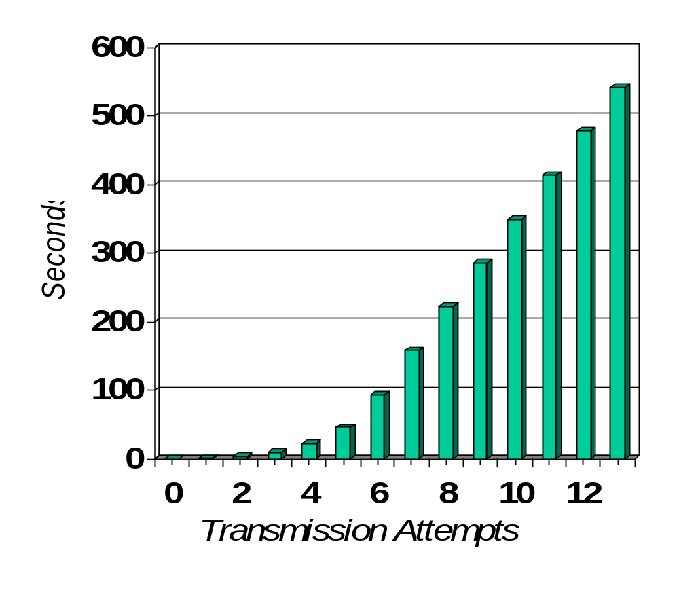
Exponential Backoff
Scenario: File transfer between two machines. Disconnect cable.
The interval between retransmission attempts in seconds is:
1.03, 3, 6, 12, 24, 48, 64, 64, 64, 64, 64, 64, 64.
Time between retrans-missions is doubled each time (Exponential Backoff Algorithm)
Timer is not increased beyond 64 seconds
TCP gives up after 13th attempt and 9 minutes.

Slide 50
TCP Congestion Control

Slide 51
TCP Congestion Control
TCP has a mechanism for congestion control. The mechanism is implemented at the sender
The window size at the sender is set as follows:
  Send Window = MIN (flow control window, congestion window)
where
  flow control window is advertised by the receiver
  congestion window is adjusted based on feedback from the network

Slide 52
TCP Congestion Control
TCP congestion control is governed by two parameters:
  Congestion Window (cwnd)
  Slow-start threshhold Value (ssthresh)
  Initial value is 2¹⁶-1
Congestion control works in two modes:
  slow start (cwnd < ssthresh)
  congestion avoidance (cwnd ≥ ssthresh)

Slide 53
Slow Start
Initial value: Set cwnd = 1
        Note: Unit is a segment size.
        CWND increments by 1 MSS (maximum segment size) at a time
The receiver sends an acknowledgement (ACK) for each Segment
        Note: Generally, a TCP receiver sends an ACK for every other segment.
Each time an ACK is received by the sender, the congestion window is increased by 1 segment:
cwnd = cwnd + 1
        If an ACK acknowledges two segments, cwnd is still increased by only 1 segment.
        Even if ACK acknowledges a segment that is smaller than MSS bytes long, cwnd is increased by 1.
Does Slow Start increment slowly? Not really.
In fact, the increase of cwnd is exponential

Slide 54
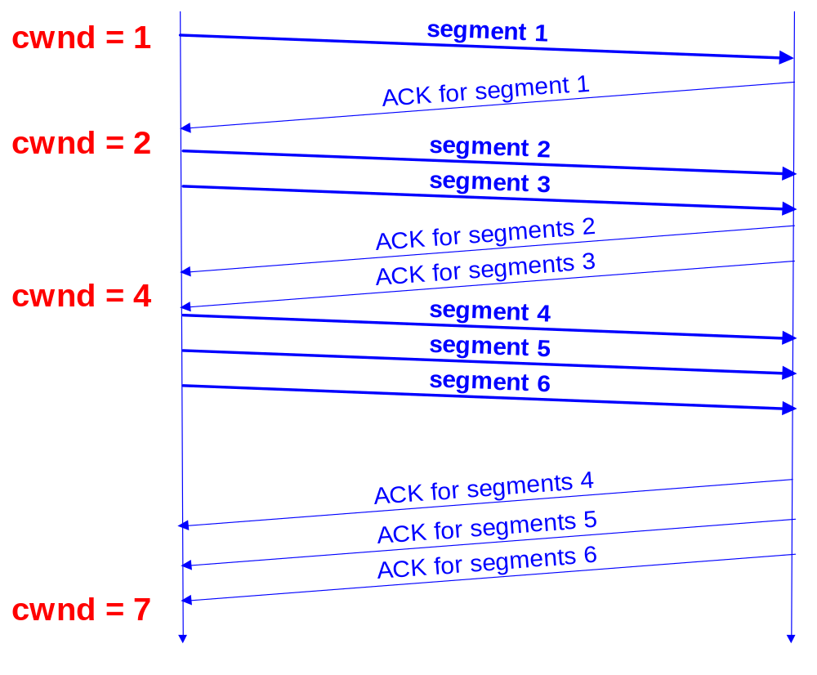
Slow Start Example
The congestion window size grows very rapidly
  For every ACK, we increase cwnd by 1 irrespective of the number of segments ACK’ed
TCP slows down the increase of cwnd when
cwnd > ssthresh

Slide 55
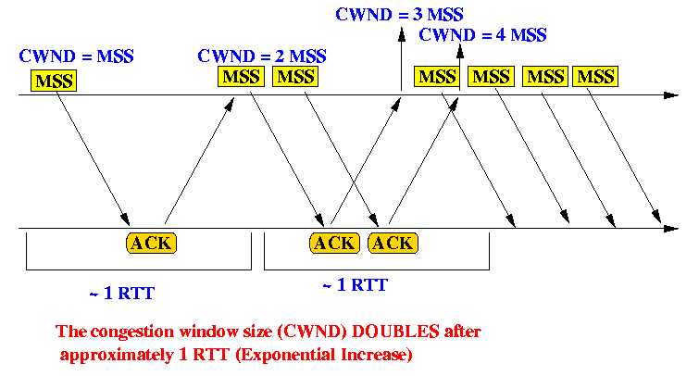
Slow Start Example

Slide 56
Congestion Avoidance
Congestion avoidance phase is started if cwnd reaches the slow-start threshold value
If cwnd ≥ ssthresh then each time an ACK is received, increment cwnd as follows:
    cwnd = cwnd + 1/ cwnd
So cwnd is increased by one only if all cwnd segments have been acknowledged.

Slide 57
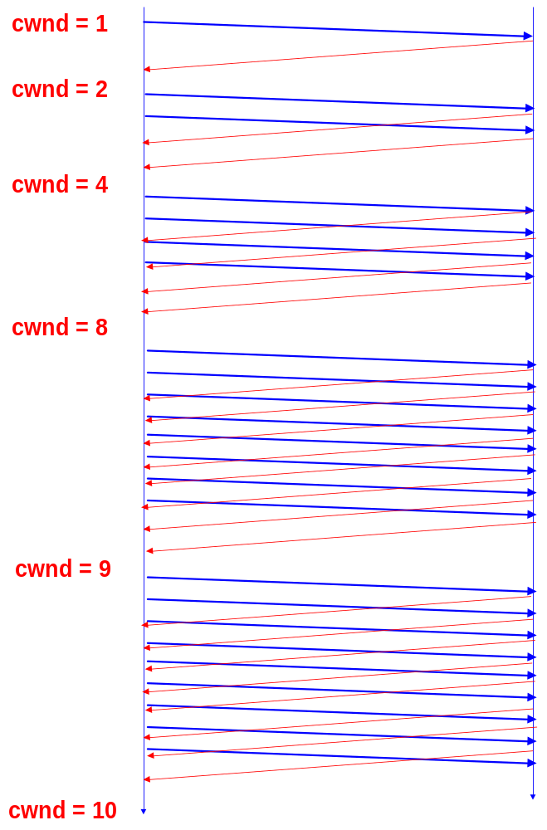
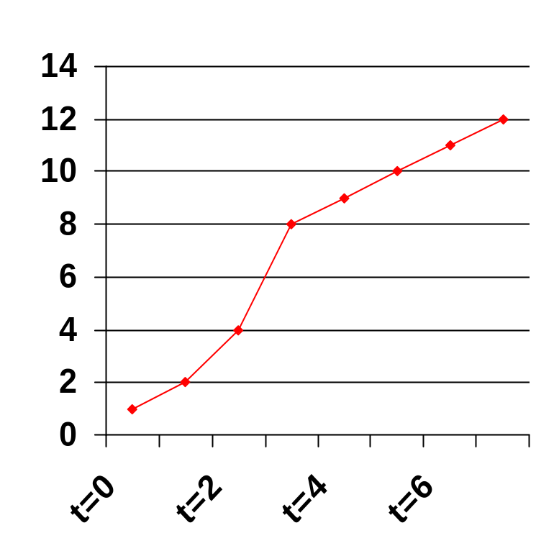
Example of
Slow Start/Congestion Avoidance
Assume that ssthresh = 8
Cwnd (in segments)
ssthresh
Roundtrip times

Slide 58
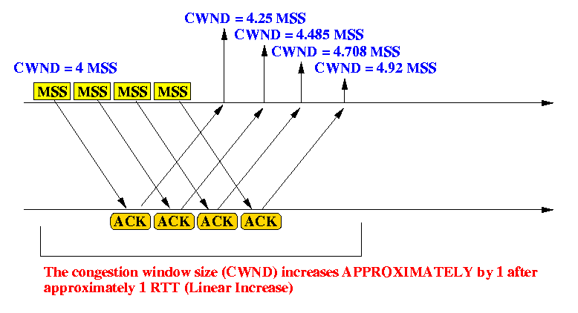
Example of Congestion Avoidance

Slide 59
Responses to Congestion
TCP assumes there is congestion if it detects a packet loss
A TCP sender can detect lost packets via:
    Timeout of a retransmission timer
    Receipt of a duplicate ACK
TCP interprets a Timeout as a binary congestion signal. When a timeout occurs, the sender performs:
  ssthresh is set to half the current size of the congestion window:
      ssthressh = cwnd / 2
  cwnd is reset to one:
      cwnd = 1
  and slow-start is entered

Slide 60
Summary of TCP congestion control
Initially:
cwnd = 1;
ssthresh =
advertised window size;
New Ack received:
if (cwnd < ssthresh)
/* Slow Start*/
cwnd = cwnd + 1;
else
/* Congestion Avoidance */
cwnd = cwnd + 1/cwnd;
Timeout:
/* Multiplicative decrease */
ssthresh = cwnd/2;
cwnd = 1;

Slide 61
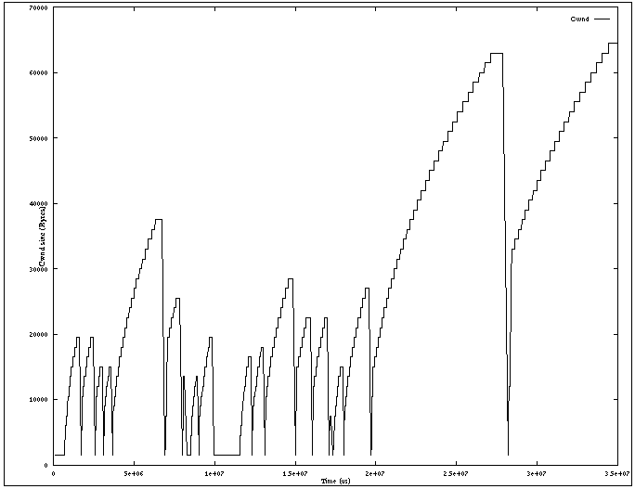
Slow Start / Congestion Avoidance
A typical plot of cwnd for a TCP connection (MSS = 1500 bytes) with TCP Tahoe:

Slide 62
Flavors of TCP Congestion Control
TCP Tahoe (1988, FreeBSD 4.3 Tahoe)
  Slow Start
  Congestion Avoidance
  Fast Retransmit
TCP Reno (1990, FreeBSD 4.3 Reno)
  Fast Recovery
New Reno (1996)
SACK (1996)
RED (Floyd and Jacobson 1993)

Slide 63
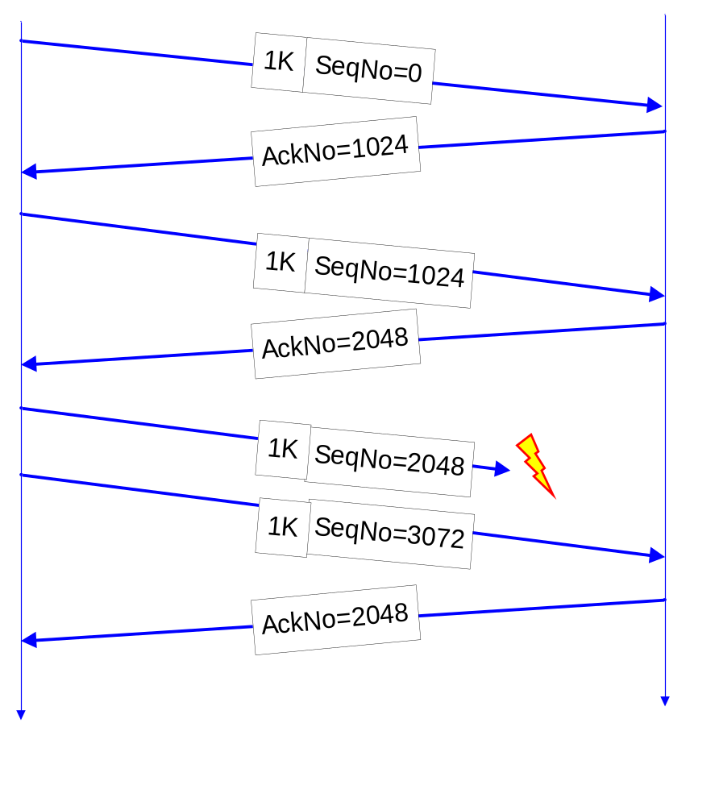
Acknowledgments in TCP (Review)
Receiver sends ACK to sender
  ACK is used for flow control, error control, and congestion control
ACK number sent is the next sequence number expected
Delayed ACK: TCP receiver normally delays transmission of an ACK (for about 200ms)
ACKs are not delayed when packets are received out of sequence
Lost segment

Slide 64
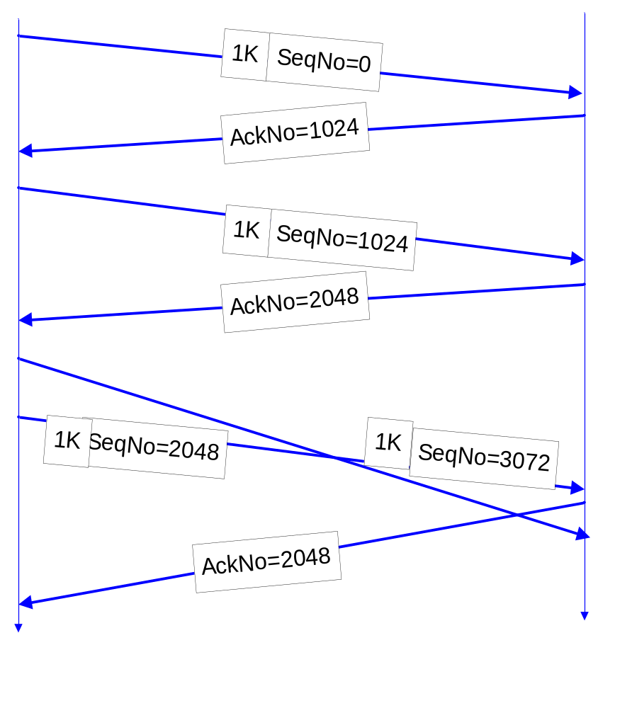
Acknowledgments in TCP (Review)
Receiver sends ACK to sender
  ACK is used for flow control, error control, and congestion control
ACK number sent is the next sequence number expected
Delayed ACK: TCP receiver normally delays transmission of an ACK (for about 200ms)
ACKs are not delayed when packets are received out of sequence
Out-of-order arrivals

Slide 65
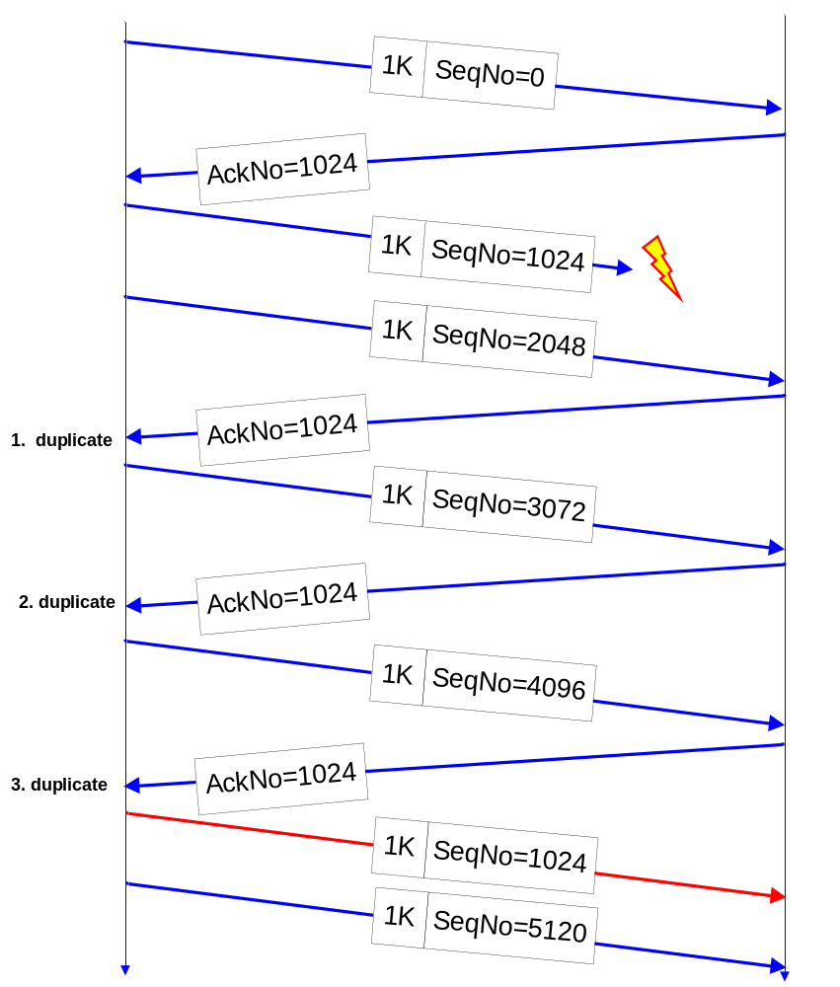
Fast Retransmit
If three or more duplicate ACKs are received in a row, the TCP sender believes that a segment has been lost.
Then TCP performs a retransmission of what seems to be the missing segment, without waiting for a timeout to happen.
Enter slow start:
  ssthresh = cwnd/2
  cwnd = 1

Slide 66
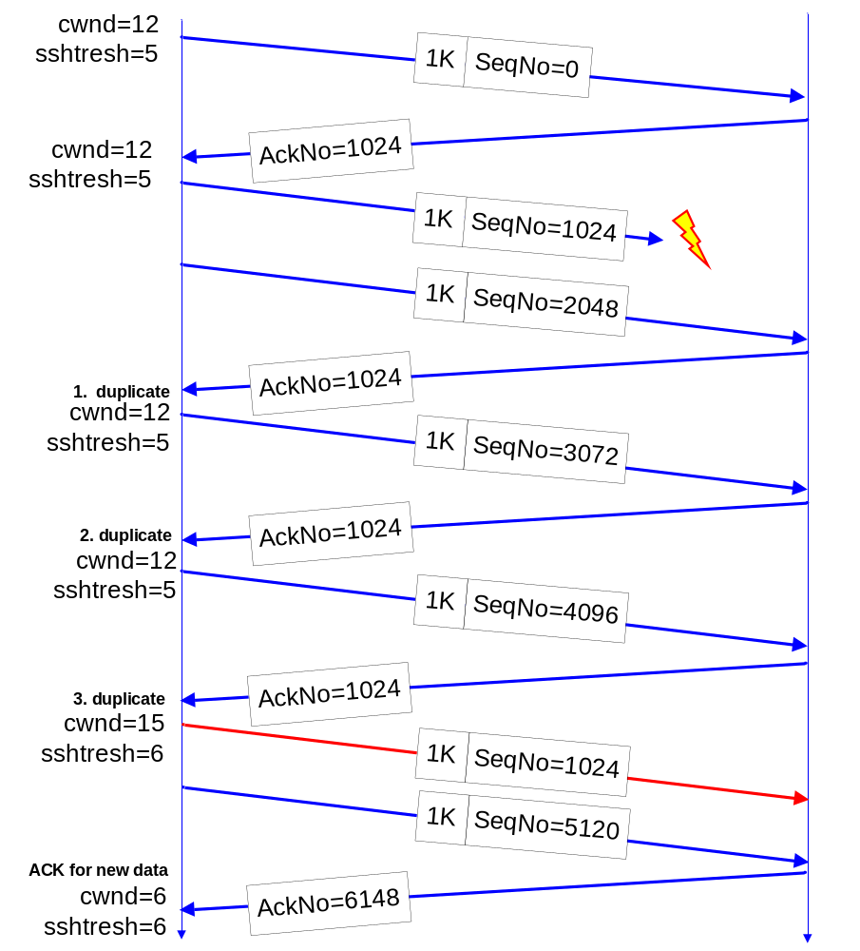
Fast Recovery
Fast recovery avoids slow start after a fast retransmit
Intuition: Duplicate ACKs indicate that data is getting through
After three duplicate ACKs set:
  Retransmit packet that is presumed lost
  ssthresh = cwnd/2
  cwnd = cwnd+3
  (note the order of operations)
  Increment cwnd by one for each additional duplicate ACK
When ACK arrives that acknowledges “new data” (here: AckNo=6148),
  cwnd=ssthresh
  enter congestion avoidance

Slide 67
TCP Reno
Duplicate ACKs:
    Fast retransmit
    Fast recovery
  → Fast Recovery avoids slow start
Timeout:
    Retransmit
    Slow Start
TCP Reno improves upon TCP Tahoe when a single packet is dropped in a round-trip time.

Slide 68
TCP Tahoe and TCP Reno
(for single segment losses)
cwnd
Taho
time
Reno
cwnd
time

Slide 69
TCP New Reno
When multiple packets are dropped, Reno has problems
Partial ACK:
  Occurs when multiple packets are lost
  A partial ACK acknowledges some, but not all packets that are outstanding at the start of a fast recovery, takes sender out of fast recovery
  →Sender has to wait until timeout occurs
New Reno:
  Partial ACK does not take sender out of fast recovery
  Partial ACK causes retransmission of the segment following the acknowledged segment
New Reno can deal with multiple lost segments without going to slow start

Slide 70
SACK
SACK = Selective acknowledgment
Issue: Reno and New Reno retransmit at most 1 lost packet per round trip time
Selective acknowledgments: The receiver can acknowledge non-continuous blocks of data (SACK 0-1023, 1024-2047)
Multiple blocks can be sent in a single segment.
TCP SACK:
  Enters fast recovery upon 3 duplicate ACKs
  Sender keeps track of SACKs and infers if segments are lost. Sender retransmits the next segment from the list of segments that are deemed lost.

Slide 71
TCP Options
Maximum Segment Size (MSS)
Window scaling
Selective Acknowledgements (SACK)
Timestamps
NOP

Slide 72
Security holes in TCP
TCP SEQUENCE NUMBER PREDICTION
First pointed out by R.T. Morris of AT&T Bell Laboratories
TCP sequence number prediction can be used to construct a TCP packet sequence without ever receiving any responses from the server
This allows to spoof a trusted host on a local network

Slide 73
Security holes in TCP – Blind Spoofing
Example: Usual Scenario for setting up a TCP connection
C -> S:SYN(ISN C)
S -> C:SYN(ISN S) , ACK(ISN C)
C -> S:ACK(ISN S)
C -> S:data
and / or
S -> C :data
Example: Unwanted Intrusion by X
(X can predict ISN S)
X -> S:SYN(ISN X) , SRC = T
S -> T:SYN(ISN S) ,
    ACK(ISN X)
X -> S:ACK(ISN S) , SRC = T
X -> S:ACK(ISN S) , SRC = T, nasty – data
the message S -> T does not go to X,
However, X was able to know its contents

Slide 74
Security holes in TCP
In Berkeley systems, the ISN is incremented by a constant amount once per second
Thus, if one initiates a legitimate connection and observes the ISN S used, the ISN S used on the next connection attempt can be easily predicted
When T receives the SYN message from S, it attempts to reset the connection
By impersonating a server port on T, and by flooding that port with apparent connection requests, a queue overflow may be generated and the S -> T message would be lost
Alternatively the attack may occur when T is down for routine maintenance

Slide 75
Security holes in TCP - Solutions
Prediction of ISN may be difficult if the ISN is incremented at a rapid rate
  TCP specification requires that this variable be incremented approximately 250,000 times per second
  Berkeley system uses a much slower rate
Another solution is randomizing the increment
However, with less number of bits for randomization, the attacker can simply compute the next random number
With some pseudo random number generators, it is possible to determine the seed and predict the random number
The other possibility is to use a cryptographic algorithm for ISN S generation
  The Data Encryption Standard (DES) is an attractive choice as the ISN S source
Performance of the initial sequence number generator is not an issue as new sequence numbers are needed only once per connection

